Slide 1
Analyzing amazon prime user data for business growth opportunities
Uncovering insights from user demographics, subscription type , and trends

Slide 2
About myself-
Name – Tartila Faiz
Email- tilumoni85@icloud.com
Address – 12345 Ingomar St, Northridge, CA 90057
Position- Data Analyst

Slide 3
Agenda
Introduction
Business Objective
Findings I
Findings II
Findings III
Recommendations

Slide 4
Business objectives-
Analyze how different user demographics, such as age and gender, contribute to Amazon Prime's business growth.
Analyze how subscription types (auto/manual) affect Amazon Prime’s business opportunities
Analyze trends (monthly vs annual subscription) to understand user behaviors to retain existing customers for long term business growth.
1
2
3

Slide 5
Business objectives-
Analyze how different user demographics, such as age and gender, contribute to Amazon Prime's business growth. | Analyze how subscription types (auto/manual) affect Amazon Prime’s business opportunities | Analyze trends (monthly vs annual subscription) to understand user behaviors to retain existing customers for long term business growth.
Notes:
What insights are we seeking regarding Amazon Prime's user base and their subscription behaviors?

Slide 6
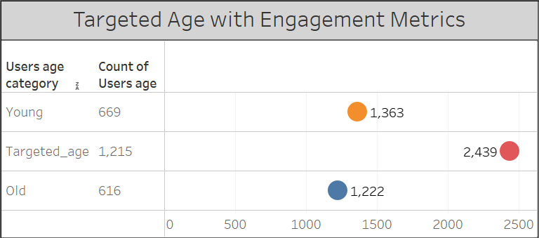
Business growth dependency on age-
Targeted age group (37 to 73) has double engagement than other two age segments
Users age category | Engagement Metrics
Targeted age (37-73) | 2439
Young (0-37) | 1363
Old ( Older than 73) | 1222

Slide 7
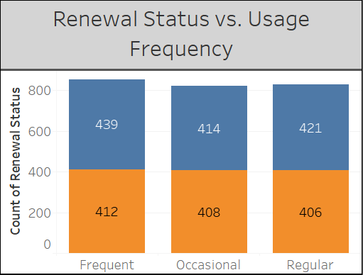
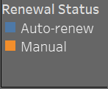
Subscription types(auto/manual) affect amazon prime’s business opportunities-
Auto renewal users are the most frequent users
Notes:
When users auto renew their membership, they tend to use it more frequently because auto renewals prevents them from forgetting to renew the membership

Slide 8
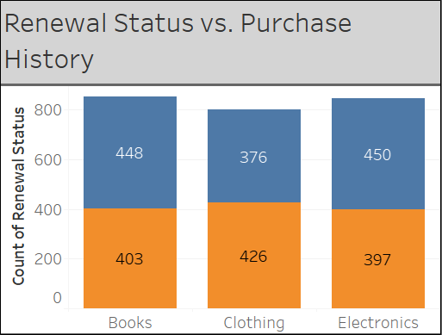

Subscription types(auto/manual) affect amazon prime’s business opportunities- auto renewal users buying more products, however clothing is in demand among manual users

Slide 9
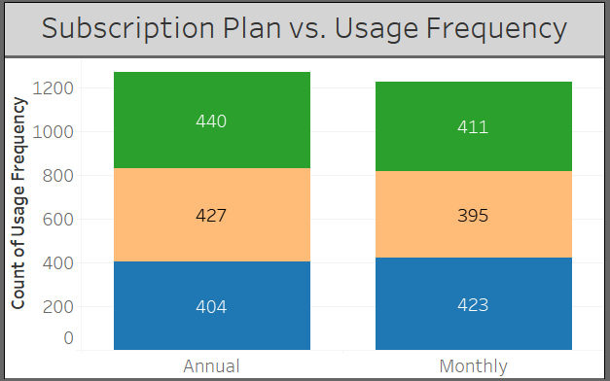
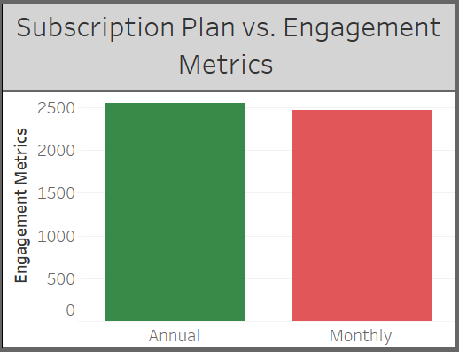
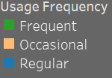
Analyze trends(monthly/annual subscription) to understand user behaviors for business growth-
Annual subscription plan users have the highest engagement metrics and they are the most frequent users.
Notes:
Area of opportunity- Monthly subscribers with regular and frequent usage
In [56]:

Slide 10
Key findings summary
1. Targeted age group (37 to 73) has double engagement than other two age segments
2. Auto renewal users are the most frequent users and they buy more products
3. Annual subscription plan users have the highest engagement metrics and they are the most frequent users

Slide 11
recommendations
Future work :
Actionable steps:
Access to monthly revenue report for further detail analysis.
Suggested strategies for targeting key demographics to ensure the users are in Annual auto renewals.
Optimizing subscription models by providing access to special discount available only to auto-renewal subscribers.
leveraging trends by providing access to special content or features available only to annual subscribers.

Slide 12
Q & A

Slide 13
APPENDIX

Slide 14
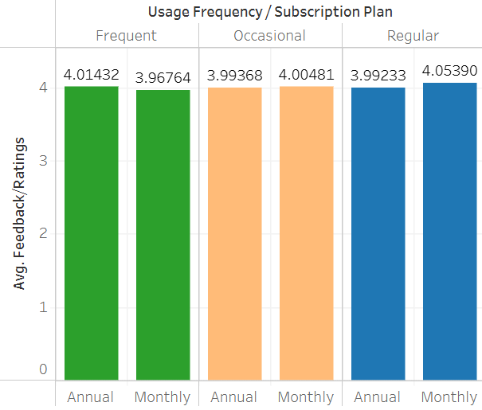
Ratings
Highest avg ratings from monthly subscribers
Notes:
According to the avg feedback/ratings, the biggest area of opportunity would be Monthly regular/occasional usage users because they give the highest ratings. It will be easier to convert their subscription to annual from monthly.

Slide 15
